Slide 1

Project Title STAT 418-Tools in Data Science
Jannet Castaneda Sanchez
May 6th, 2025

Slide 2
Dataset & Acquisition Method
Purpose: FDA Drug Recall
Include:
FDA Drug Enforcement Reports API
Variables: Product Description, Reason for Recall, Classification (I, II, III)
Acquisition: R with httr + jsonlite; paginated JSON API
Status: Initial 100 records retrieved and parsed
Notes:
Data Source: IMDB Top 250 + User Reviews
Method: HTML scraping using Python (requests + BeautifulSoup)
Fields: Title, Genre, Rating, Review Text, Year
Goal: Predict average rating from review sentiment and genre

Slide 3
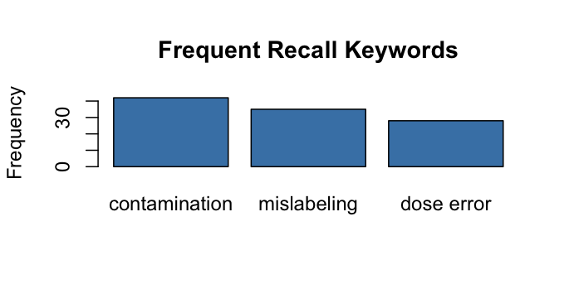
Exploratory Data Analysis
Notes:
Example Plot Ideas:
Bar plot of top genres
Histogram of movie ratings
Word cloud of frequent review terms

Slide 4
Planned Model & Product
Purpose: Examine trends in recall classifications over time & identify common reasons for recall.
Include:
Model Type: Logistic Regression to classify the sentiment of reviews
What the user can do: dropdowns, sliders, text input, prediction button, etc.
App Tech: Shiny in R/Python, model served via Flask or Plumber, deployed via shinyapps.io or EC2
Stretch Goal: Anything extra if time allows

